Slide 1
Design Patterns. Flyweight

Slide 2
Table of content
Intent
Problem
Discussion
Structure
Example

Slide 3
Intent
Use sharing to support large numbers of fine-grained objects efficiently.
The Motif GUI strategy of replacing heavy-weight widgets with light-weight gadgets.

Slide 4
Problem
Designing objects down to the lowest levels of system "granularity" provides optimal flexibility, but can be unacceptably expensive in terms of performance and memory usage.
Notes:
Проектирование объектов вплоть до самых низких уровней «гранулярности» системы обеспечивает оптимальную гибкость, но может быть неприемлемо дорогим с точки зрения производительности и использования памяти.

Slide 5
Discussion
The Flyweight pattern describes how to share objects to allow their use at fine granularity without prohibitive cost. Each "flyweight" object is divided into two pieces: the state-dependent (extrinsic) part, and the state-independent (intrinsic) part. Intrinsic state is stored (shared) in the Flyweight object. Extrinsic state is stored or computed by client objects, and passed to the Flyweight when its operations are invoked.
Notes:
Шаблон Flyweight описывает, как обмениваться объектами, чтобы их использование можно было использовать при тонкой детализации без чрезмерной стоимости. Каждый «flyweight» объект разделен на две части: состояние-зависимой (внешней) стороны, и состояние-независимого (внутренней) части. Внутреннее состояние сохраняется (совместно используется) в объекте Flyweight. Внешнее состояние хранится или вычисляется клиентскими объектами и передается Flyweight при его выполнении.

Slide 6
Discussion
An illustration of this approach would be Motif widgets that have been re-engineered as light-weight gadgets. Whereas widgets are "intelligent" enough to stand on their own; gadgets exist in a dependent relationship with their parent layout manager widget. Each layout manager provides context-dependent event handling, real estate management, and resource services to its flyweight gadgets, and each gadget is only responsible for context-independent state and behavior.

Slide 7
Structure
Flyweights are stored in a Factory's repository. The client restrains herself from creating Flyweights directly, and requests them from the Factory. Each Flyweight cannot stand on its own. Any attributes that would make sharing impossible must be supplied by the client whenever a request is made of the Flyweight. If the context lends itself to "economy of scale" (i.e. the client can easily compute or look-up the necessary attributes), then the Flyweight pattern offers appropriate leverage.

Slide 8
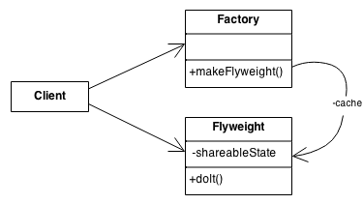
Structure

Slide 9
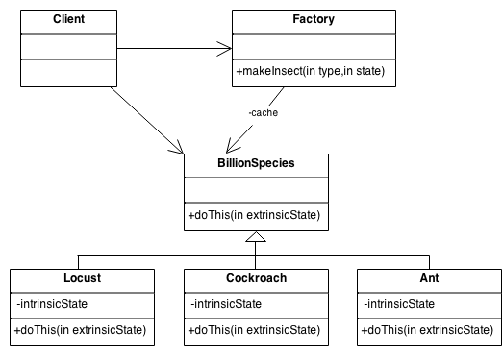
Structure
Notes:
The Ant, Locust, and Cockroach classes can be "light-weight" because their instance-specific state has been de-encapsulated, or externalized, and must be supplied by the client.

Slide 10
Example
The Flyweight uses sharing to support large numbers of objects efficiently. Modern web browsers use this technique to prevent loading same images twice. When browser loads a web page, it traverse through all images on that page. Browser loads all new images from Internet and places them the internal cache. For already loaded images, a flyweight object is created, which has some unique data like position within the page, but everything else is referenced to the cached one.

Slide 11

Example

Slide 12
Check list
Ensure that object overhead is an issue needing attention, and, the client of the class is able and willing to absorb responsibility realignment.
Divide the target class's state into: shareable (intrinsic) state, and non-shareable (extrinsic) state.
Remove the non-shareable state from the class attributes, and add it the calling argument list of affected methods.
Create a Factory that can cache and reuse existing class instances.
The client must use the Factory instead of the new operator to request objects.
The client (or a third party) must look-up or compute the non-shareable state, and supply that state to class methods.

Slide 13
Rules of thumb
Whereas Flyweight shows how to make lots of little objects, Facade shows how to make a single object represent an entire subsystem.
Flyweight is often combined with Composite to implement shared leaf nodes.
Terminal symbols within Interpreter's abstract syntax tree can be shared with Flyweight.
Flyweight explains when and how State objects can be shared.

Slide 14
Rules of thumb
The Singleton design pattern is one of the most inappropriately used patterns. Singletons are intended to be used when a class must have exactly one instance, no more, no less. Designers frequently use Singletons in a misguided attempt to replace global variables. A Singleton is, for intents and purposes, a global variable. The Singleton does not do away with the global; it merely renames it.

Slide 15
Rules of thumb
When is Singleton unnecessary? Short answer: most of the time. Long answer: when it's simpler to pass an object resource as a reference to the objects that need it, rather than letting objects access the resource globally. The real problem with Singletons is that they give you such a good excuse not to think carefully about the appropriate visibility of an object. Finding the right balance of exposure and protection for an object is critical for maintaining flexibility.

Slide 16
Rules of thumb
Our group had a bad habit of using global data, so I did a study group on Singleton. The next thing I know Singletons appeared everywhere and none of the problems related to global data went away. The answer to the global data question is not, "Make it a Singleton." The answer is, "Why in the hell are you using global data?" Changing the name doesn't change the problem. In fact, it may make it worse because it gives you the opportunity to say, "Well I'm not doing that, I'm doing this" – even though this and that are the same thing.

